Slide 1

NEEDATICKET
CONCERT TICKETS
Notes:
To change the image on this slide, select the picture and delete it. Then click the Pictures icon in the placeholder to insert your own image.

Slide 2
Arbeitsteilung
Berisa – Android App? | Java App
Blaschke – Database | Webservices
Judth – Database | Webservices
Winkler – Android App | Project Management

Slide 3
Requirements
Android App
Login
Register
Logout
Show all concerts
Show tickets to concert
Buy tickets
Show bought tickets
Show user data
Change user data
------------------------------------
Show wallet
Add/Cashout balance
Webservice connection
Java App
Login
Register
Logout
Show dashboard
Show all tickets
Create tickets
Show transactions
Show user data
Change user data
Show wallet
Add/Cashout balance
Webservice connection
Webservice
Routes as specified
Bearer authentication
Sign in / register auth.
Documentation
Database
Basic tables
Spatial-Index
Data-Warehouse

Slide 4
Android App

Slide 5
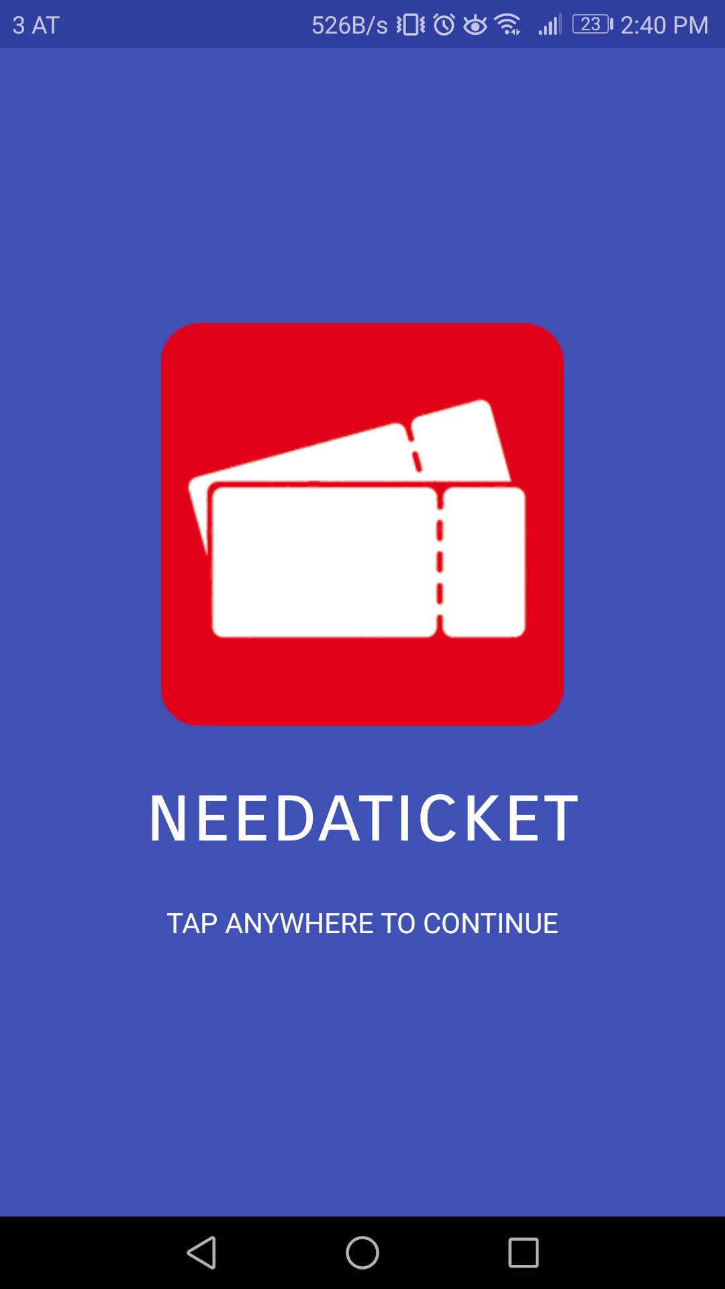
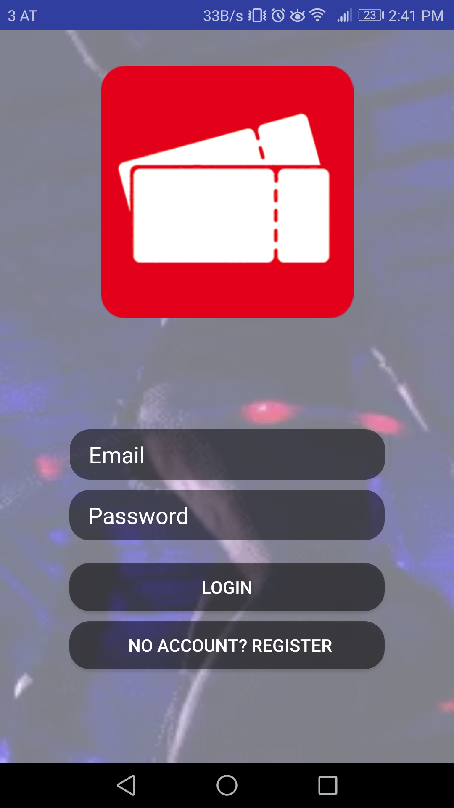
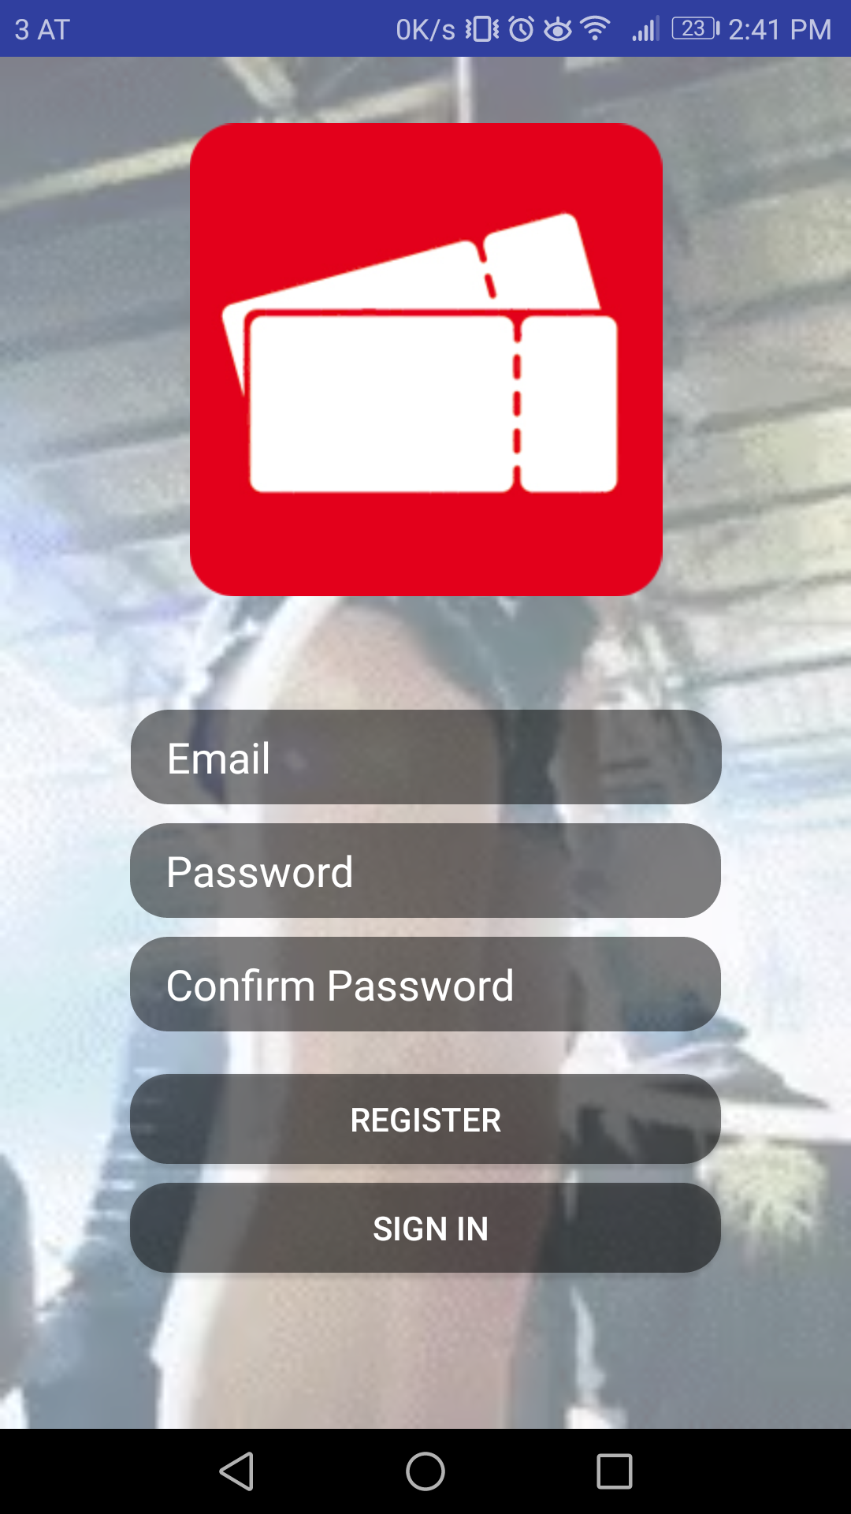
Android App
Welcome Screen
Login
Register

Slide 6
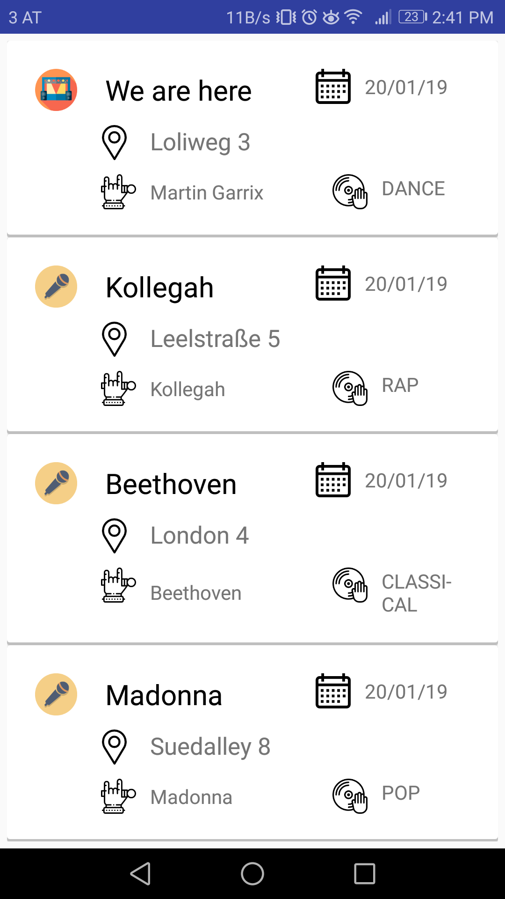
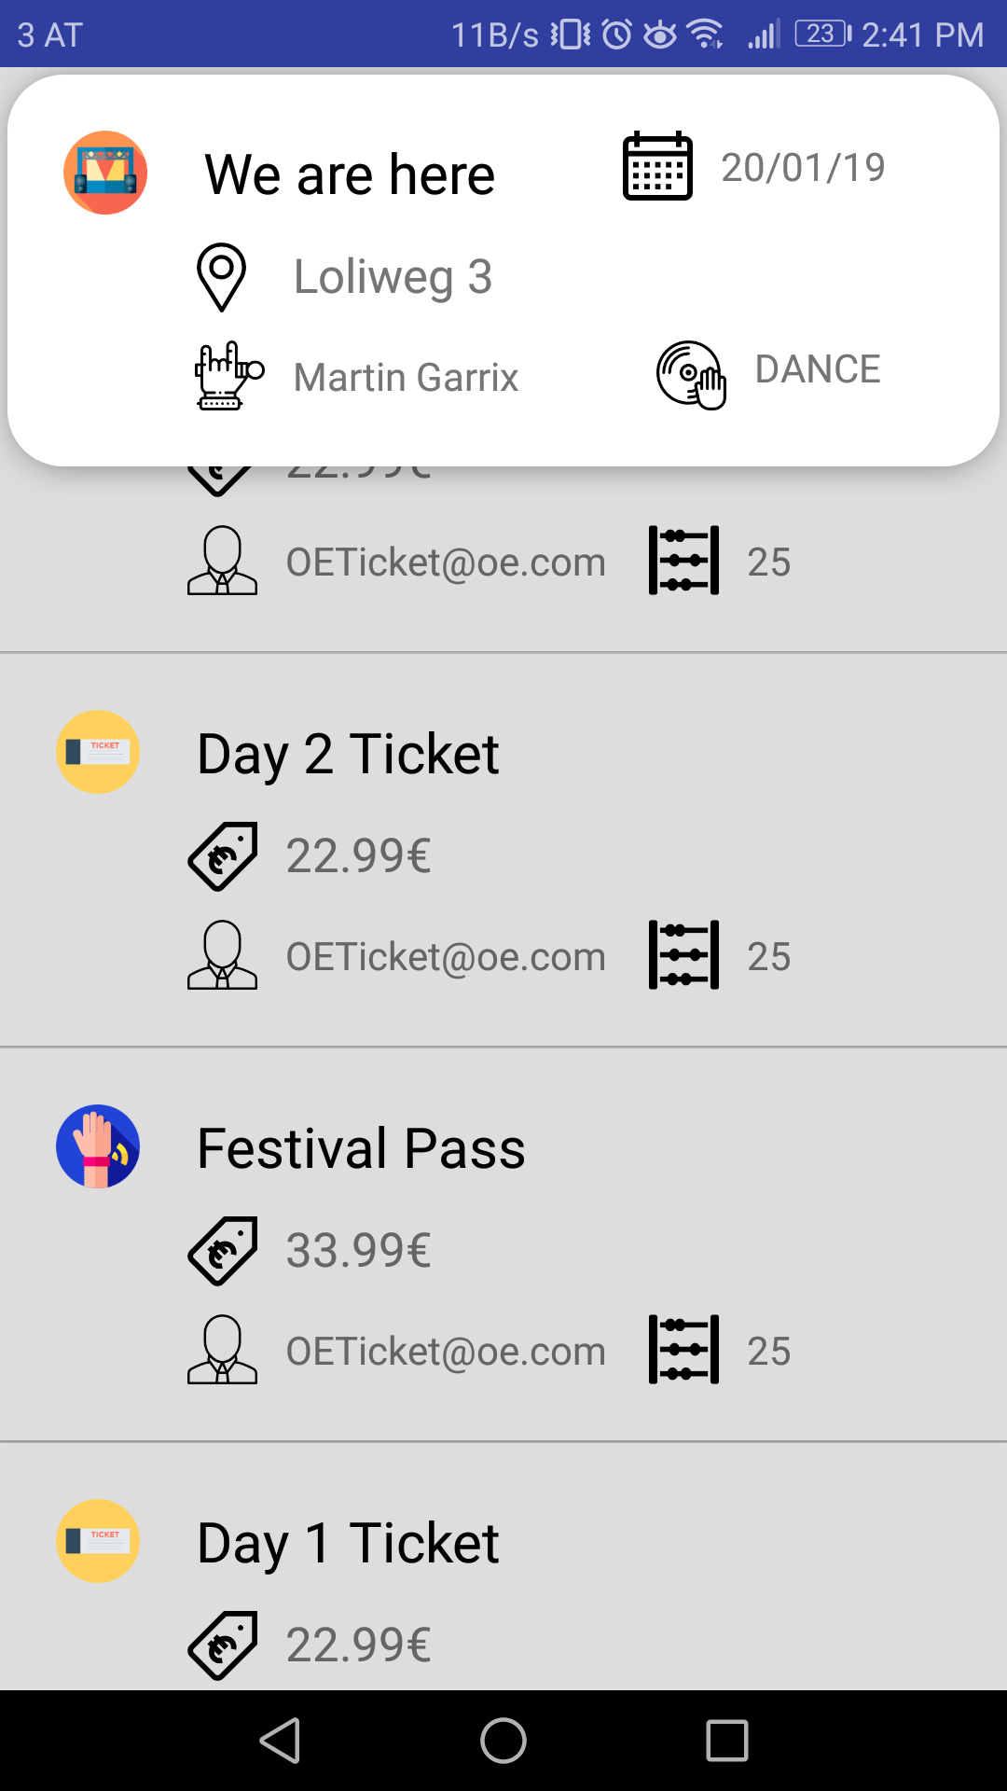
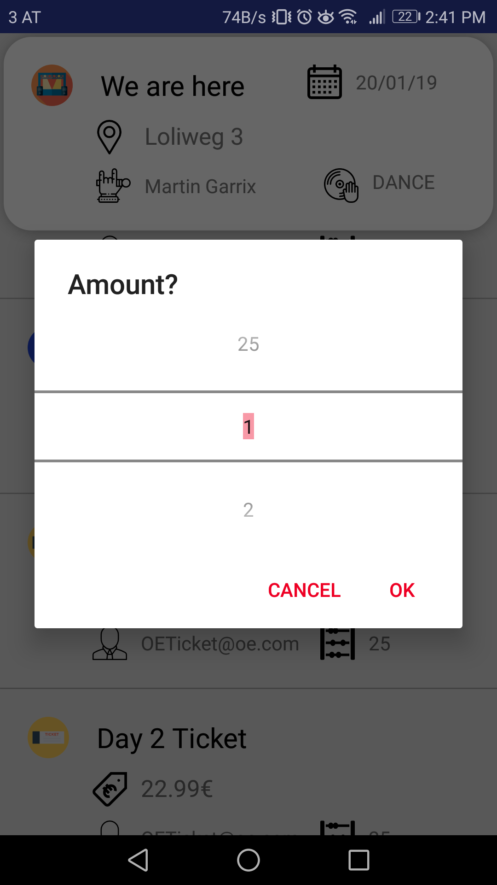
Android App
Concert list
Ticket list
Amount Picker

Slide 7
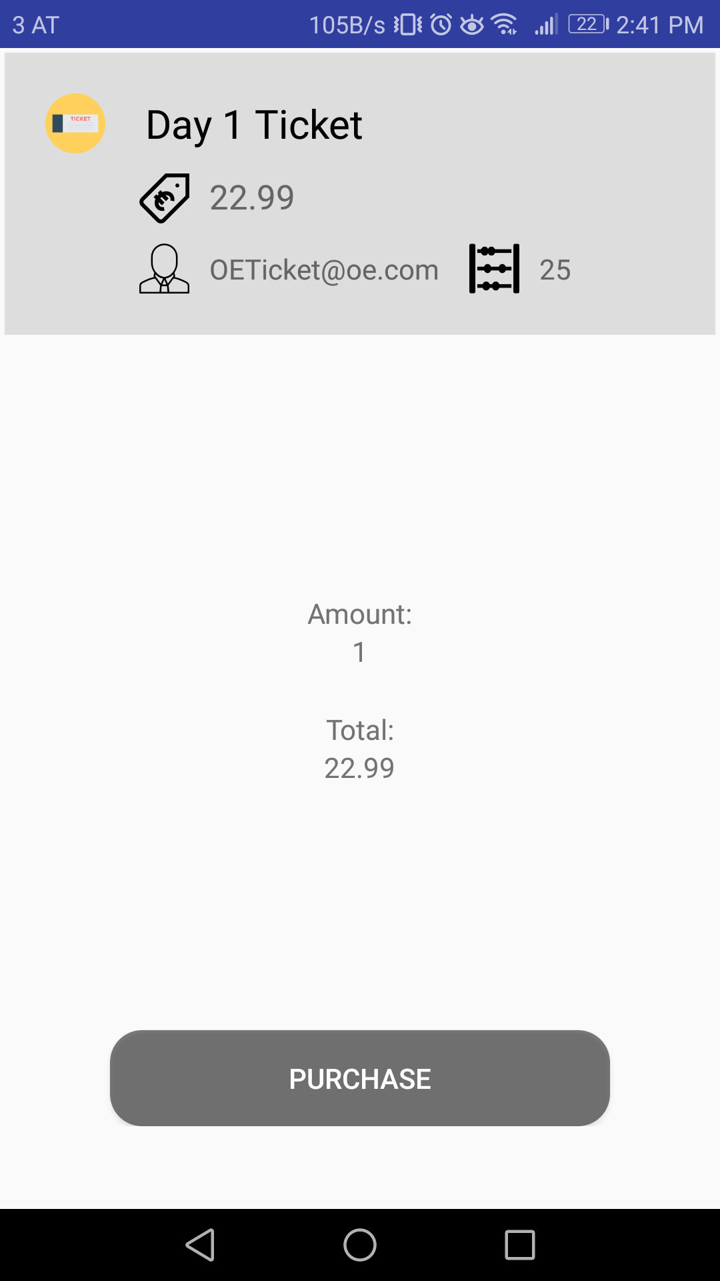
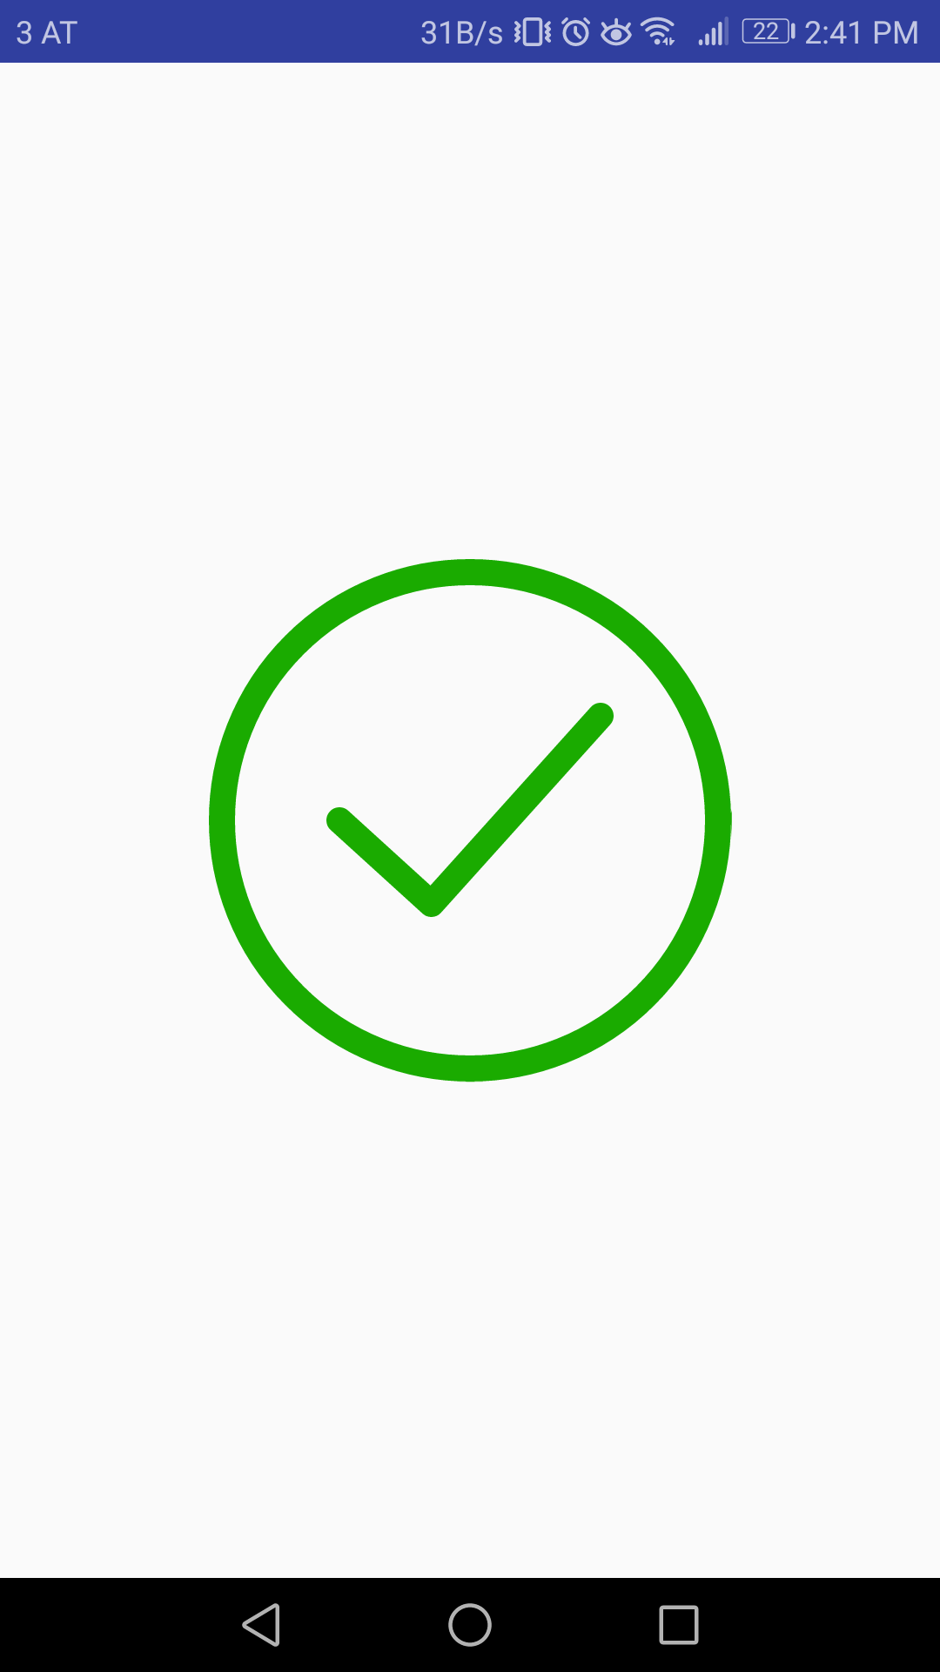
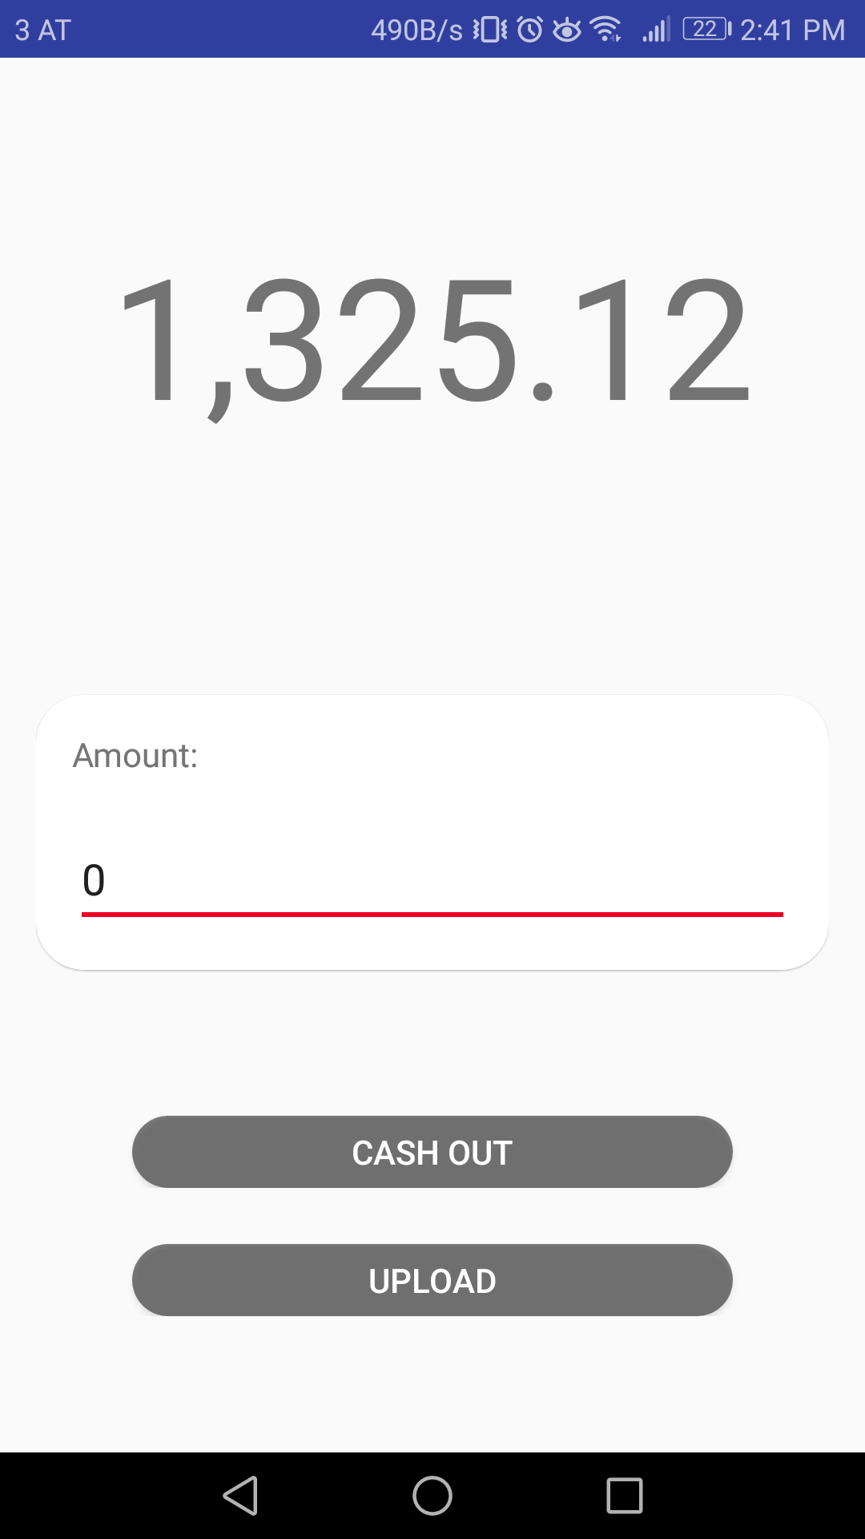
Android App
Buy ticket(s)
Checkmark (Anim)
Wallet (Anim)

Slide 8
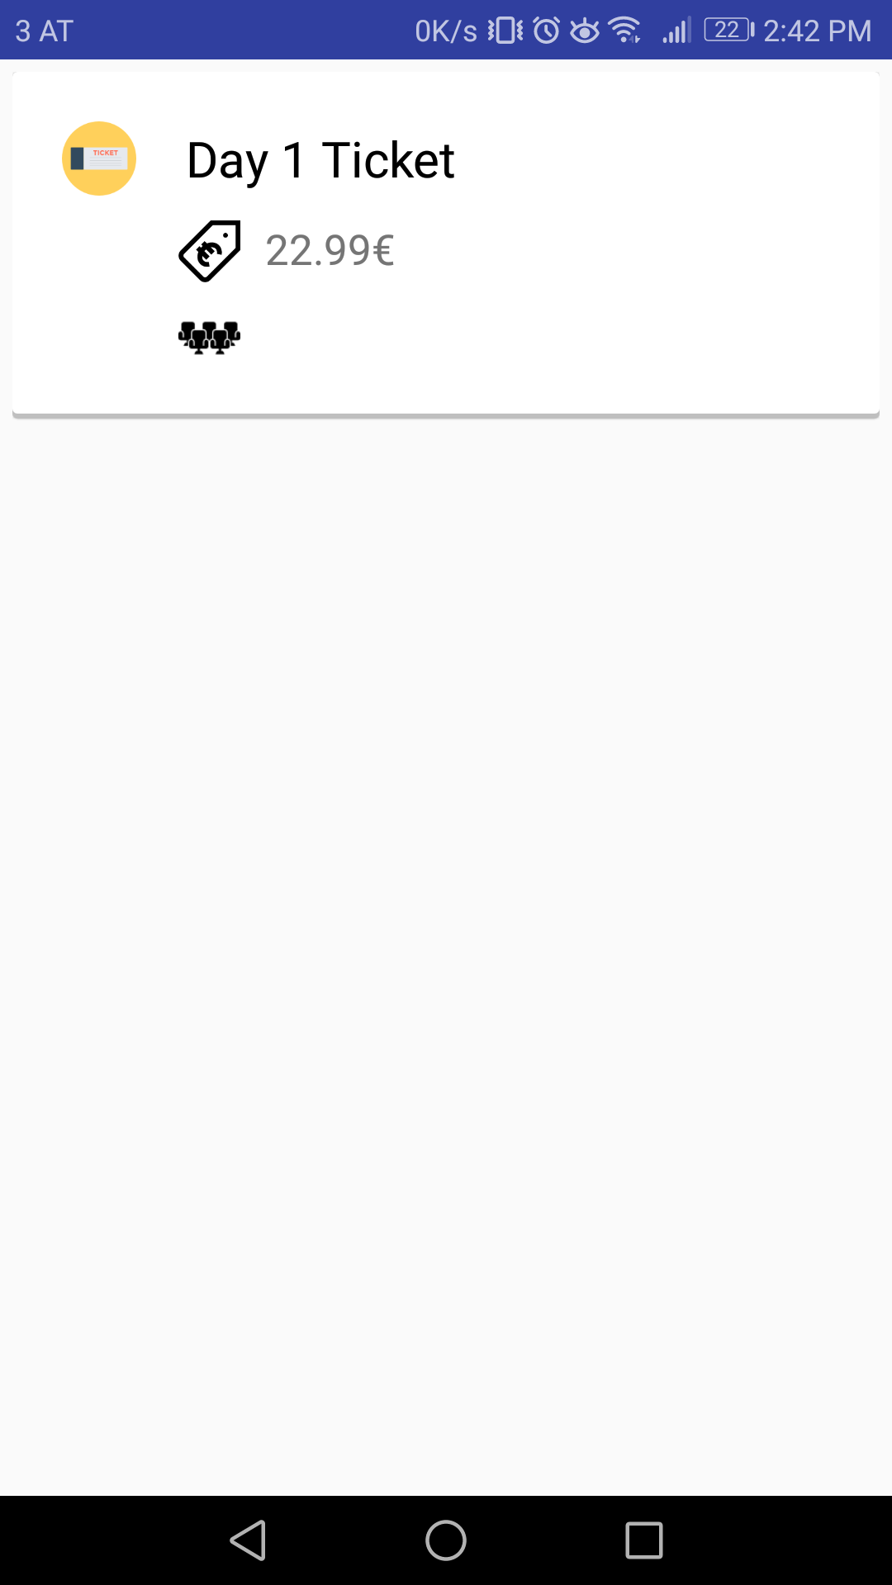
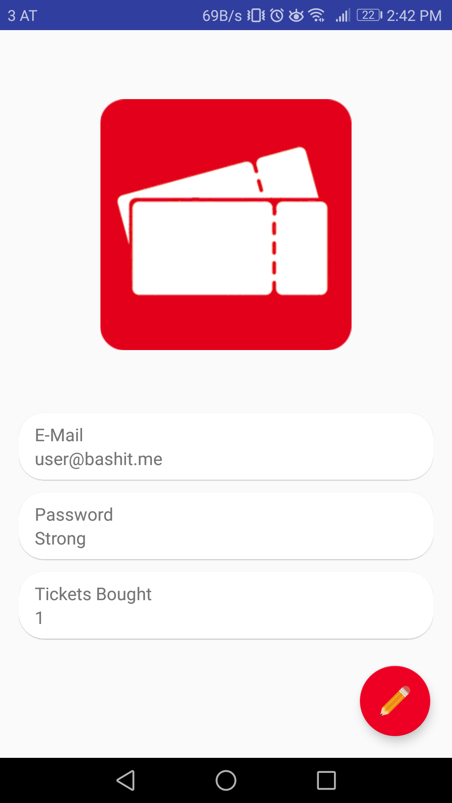
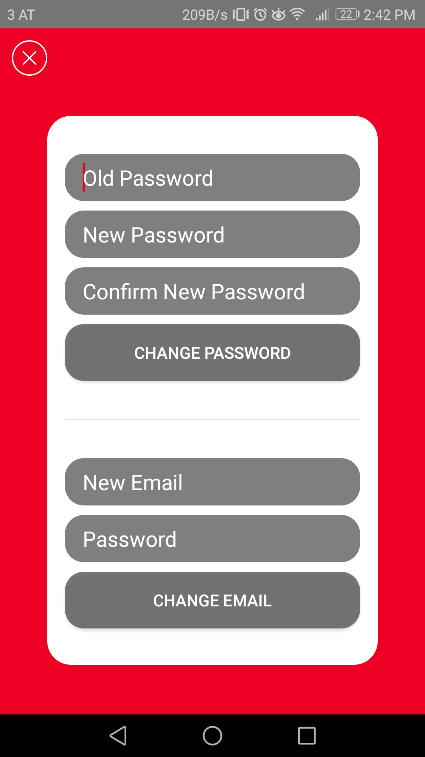
Android App
Bought tickets
User data
Change UD (Anim)

Slide 9
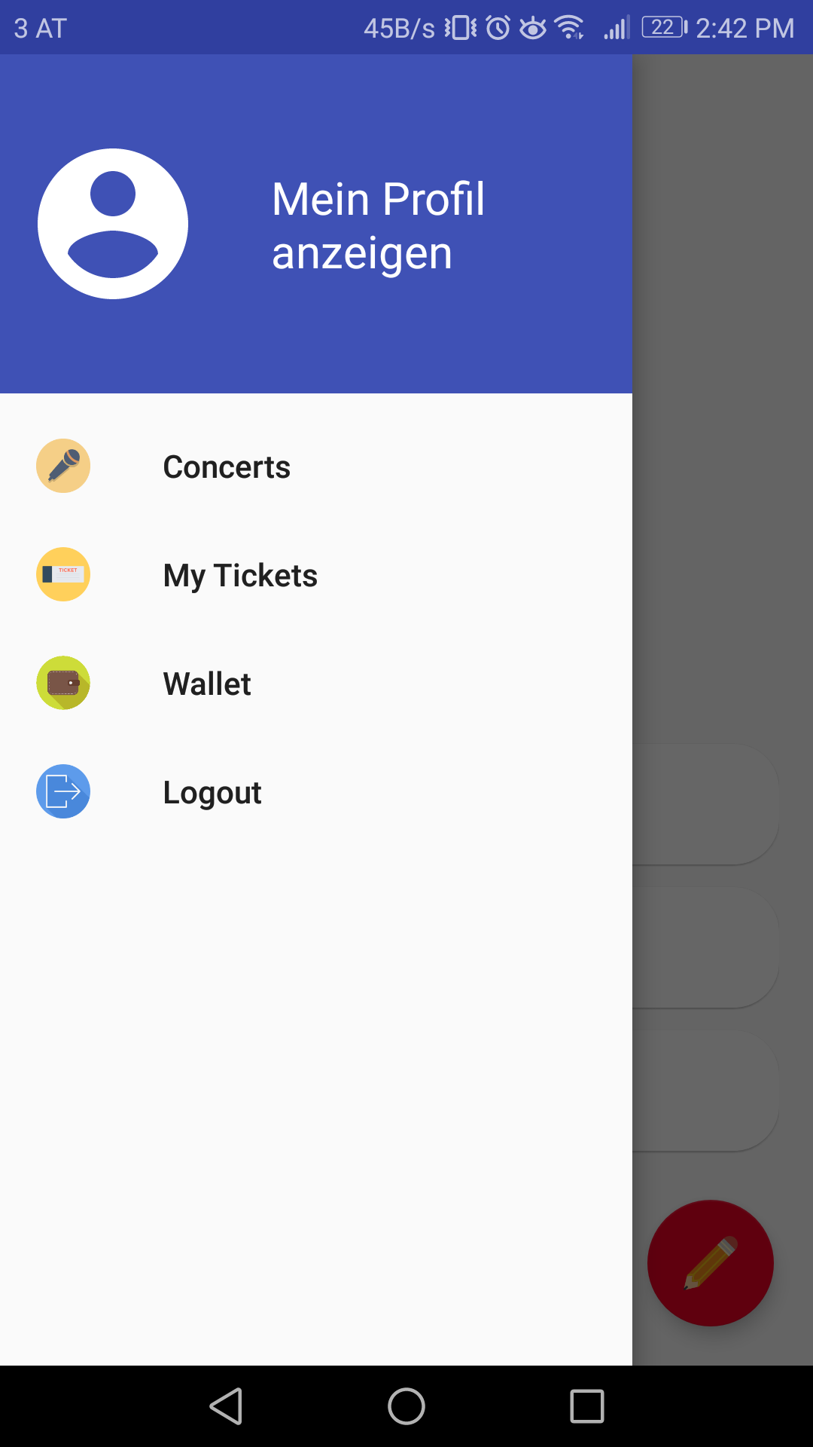
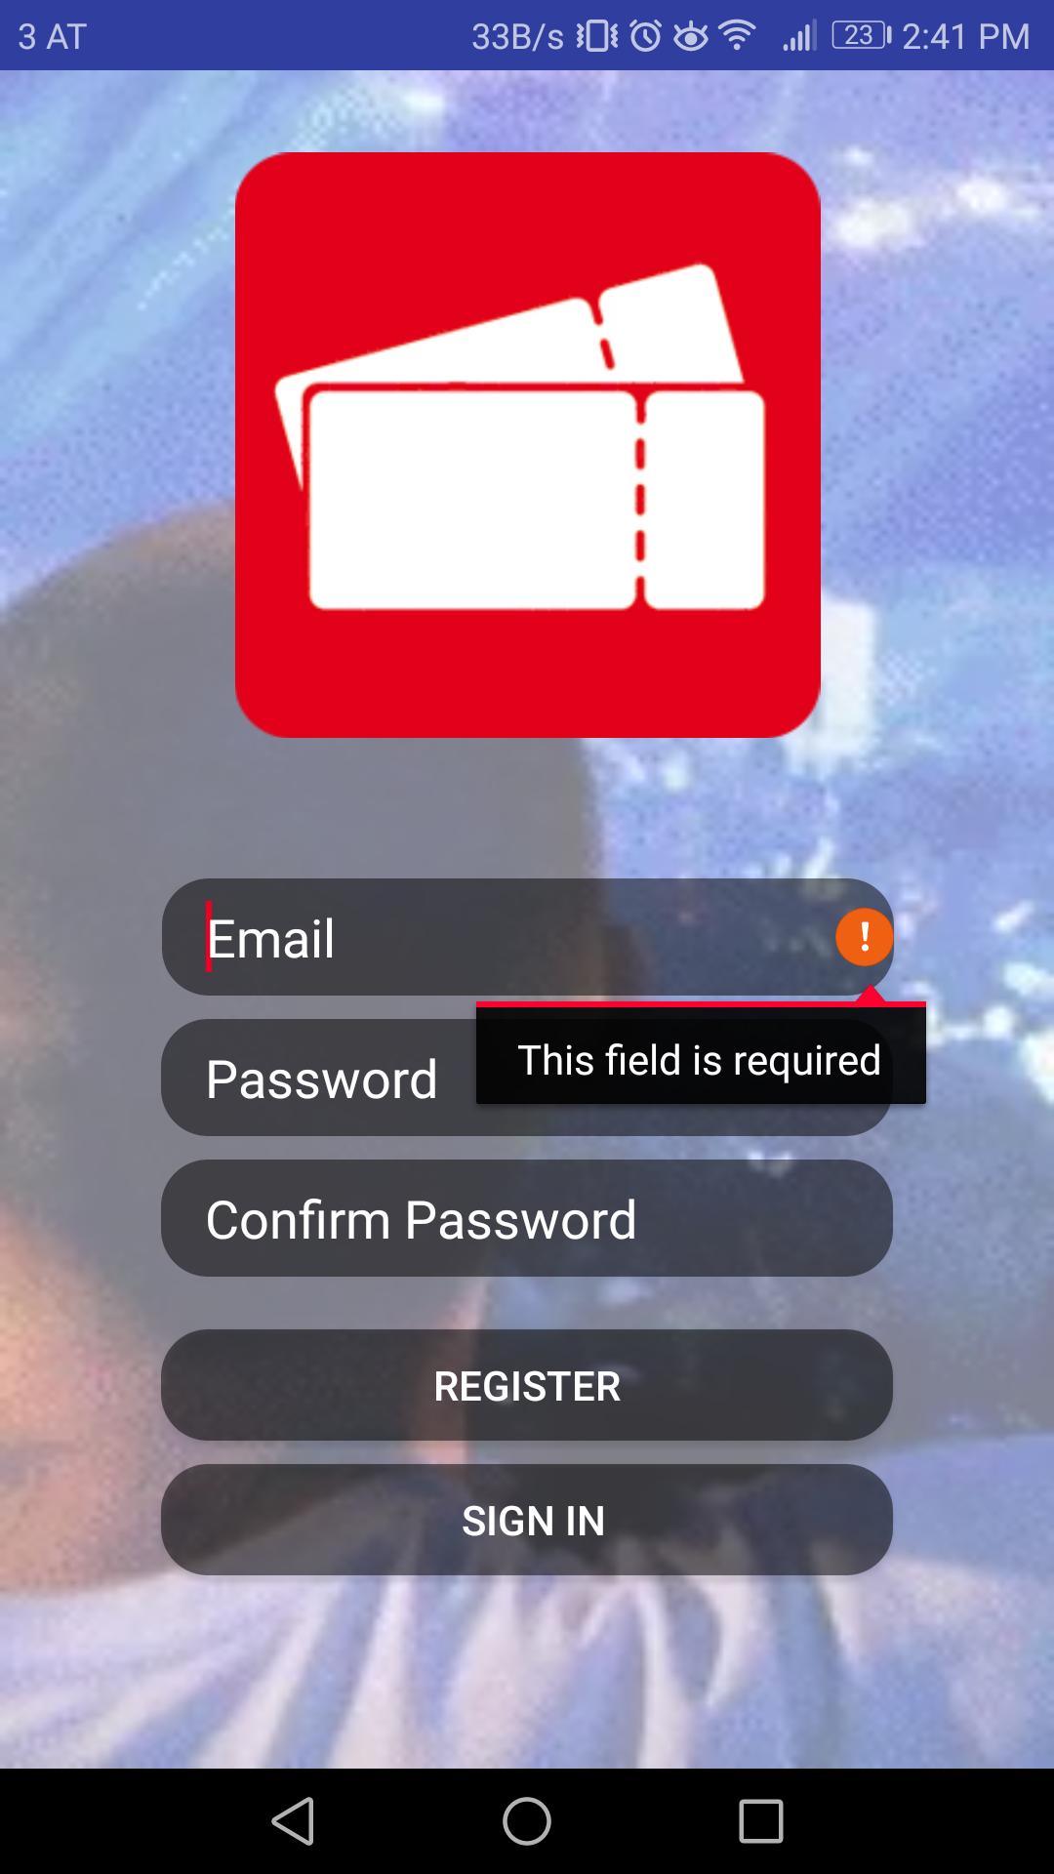
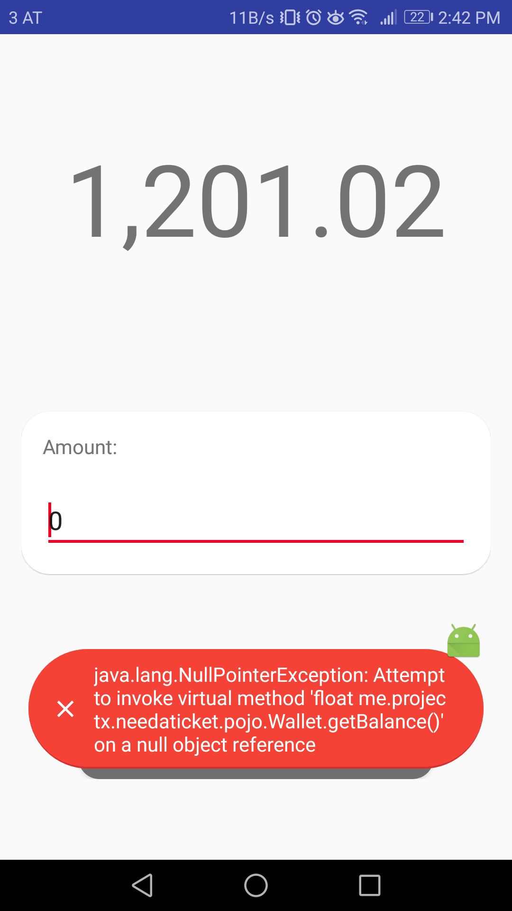
Android App
Navigation
Field Errors
Toast Errors

Slide 10

Android App
Continuous Inspection
Code Quality:
Bugs
Vulnerabilities
Technical Debt
Unclean Code
Application Security:
CWE
OWASP
SANS

Slide 11
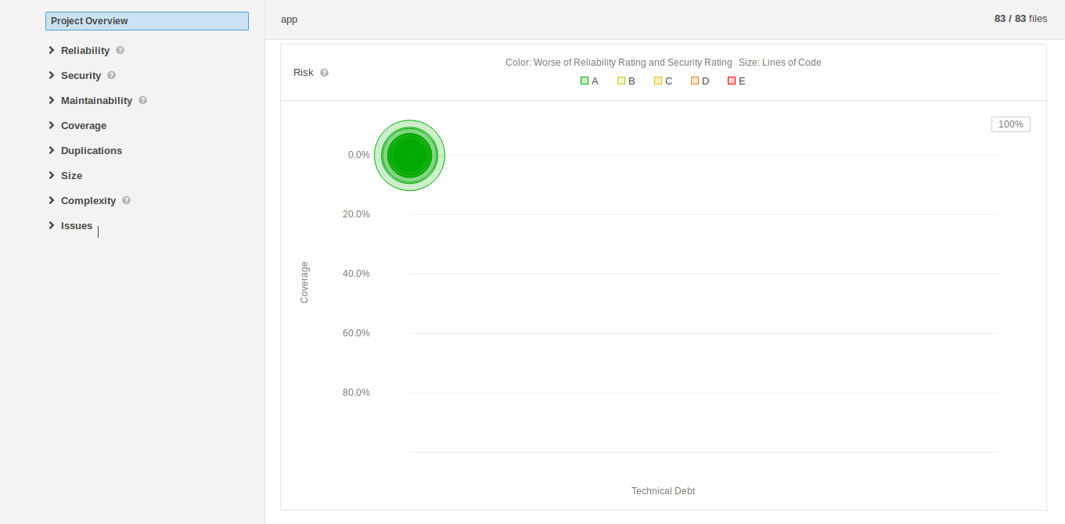
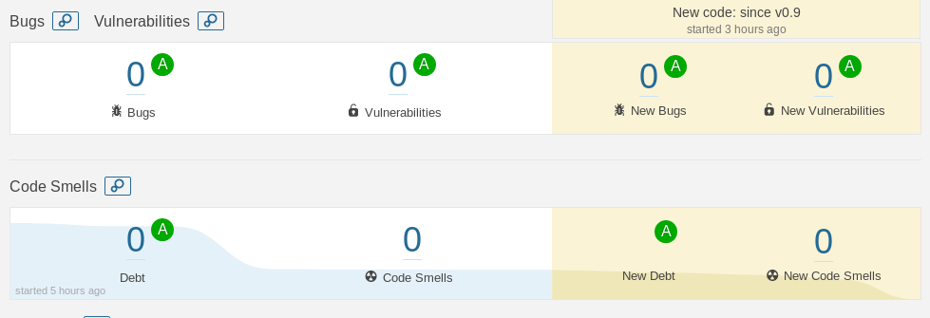
Android App
Clean Code

Slide 12
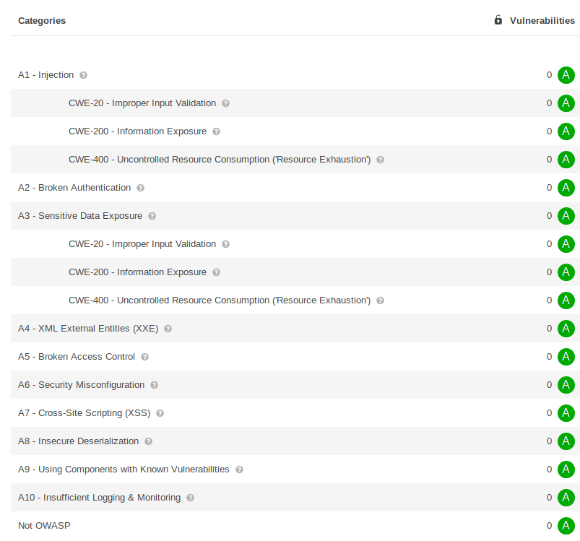
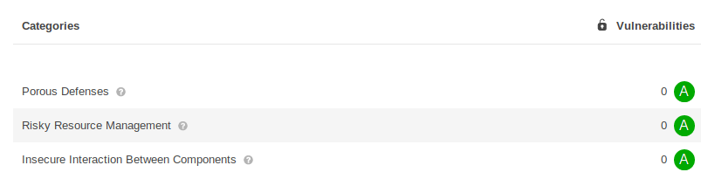
Android App
CWE (Common Weakness Enumeration)
OWASP Top 10
SANS Top 25
OWASP: Most Critical Web Application Security Risks
SANS: Most Dangerous Software Errors

Slide 13
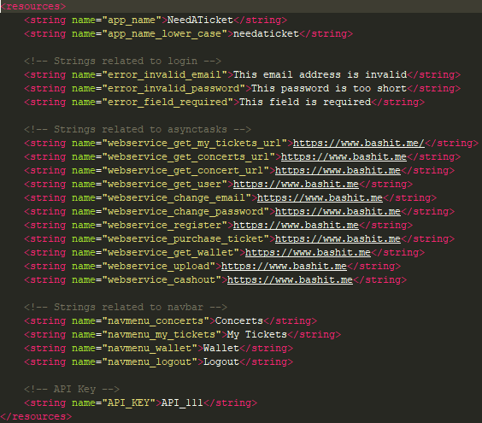
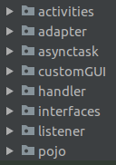
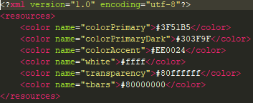
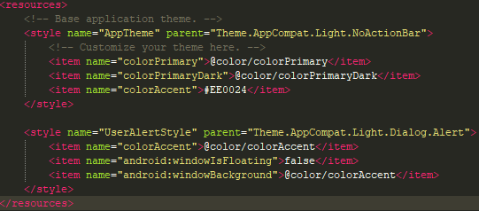
Android App
Structure

Slide 14
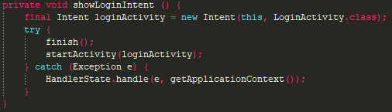
Android App
Activity Stacking

Slide 15
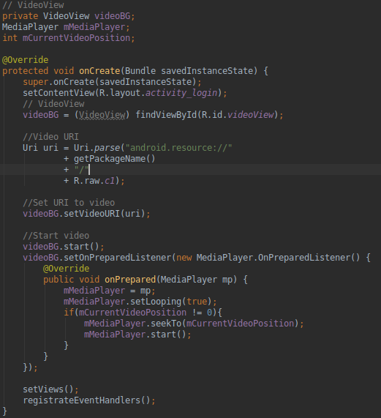
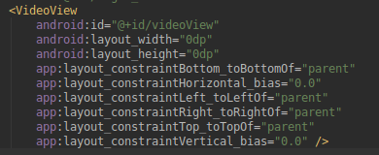
Android App
Video Background

Slide 16
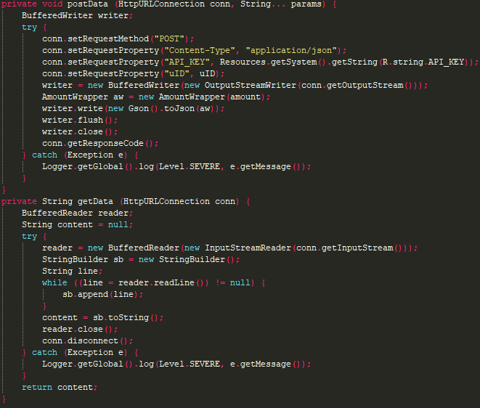
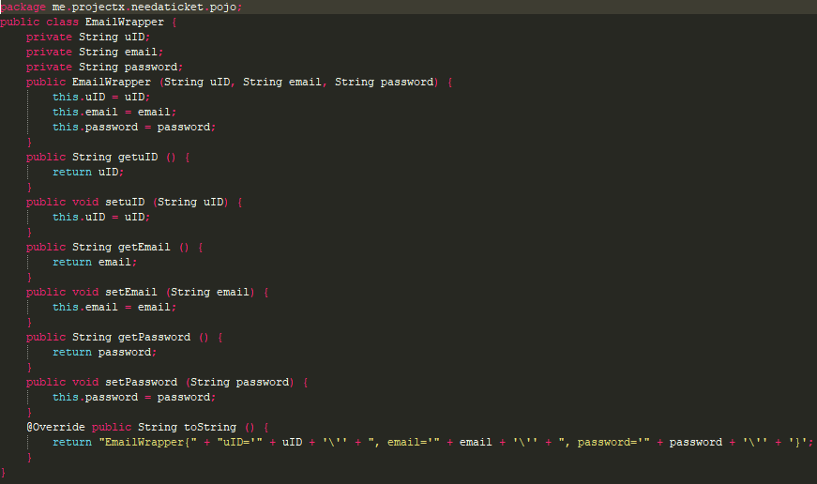
Android App
Webservice Calls

Slide 17
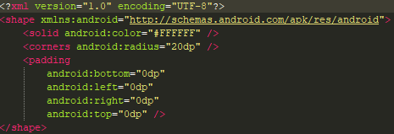
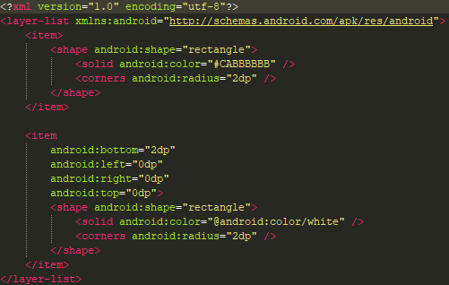
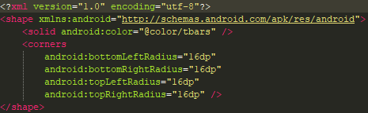
Android App
Drawables

Slide 18
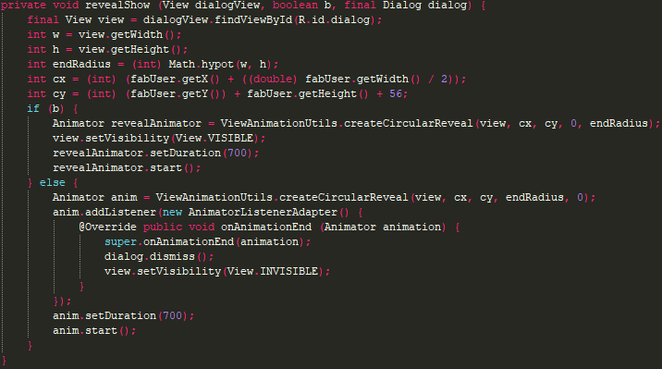
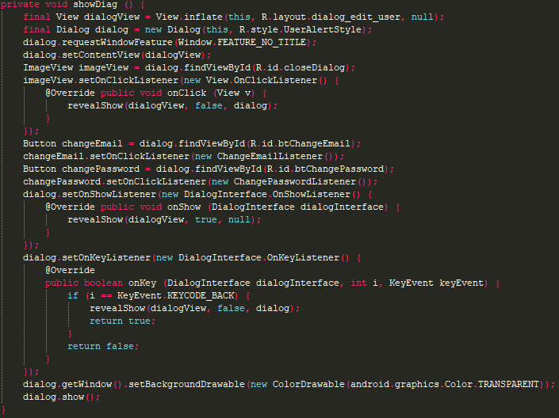
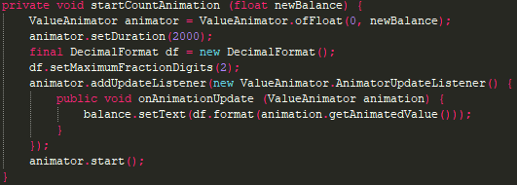
Android App
Animations

Slide 19
Java Application

Slide 20
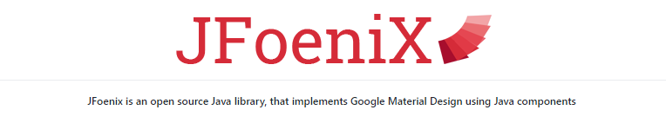


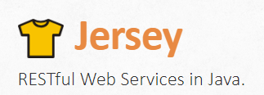
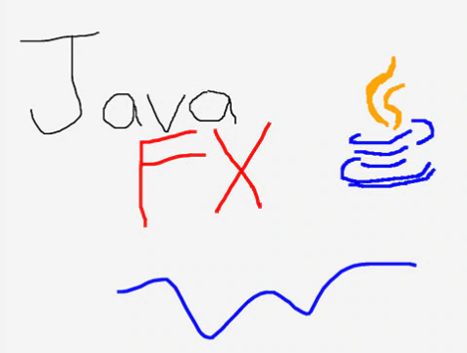
Java App – Tech

Slide 21
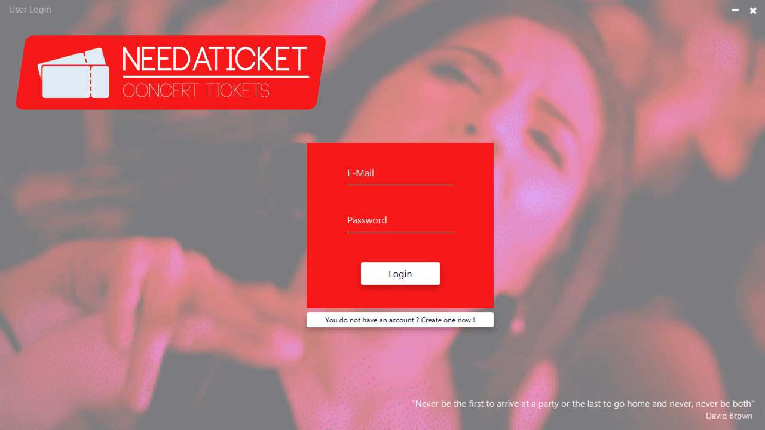
Login / Register

Slide 22
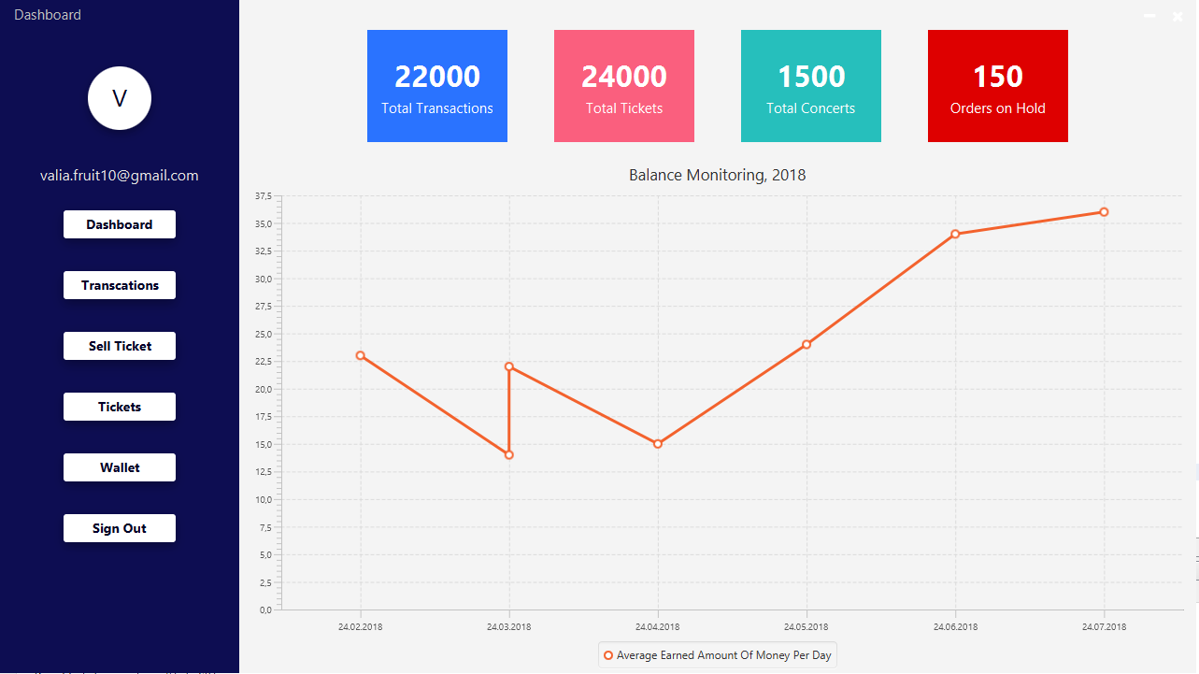
Dashboard

Slide 23
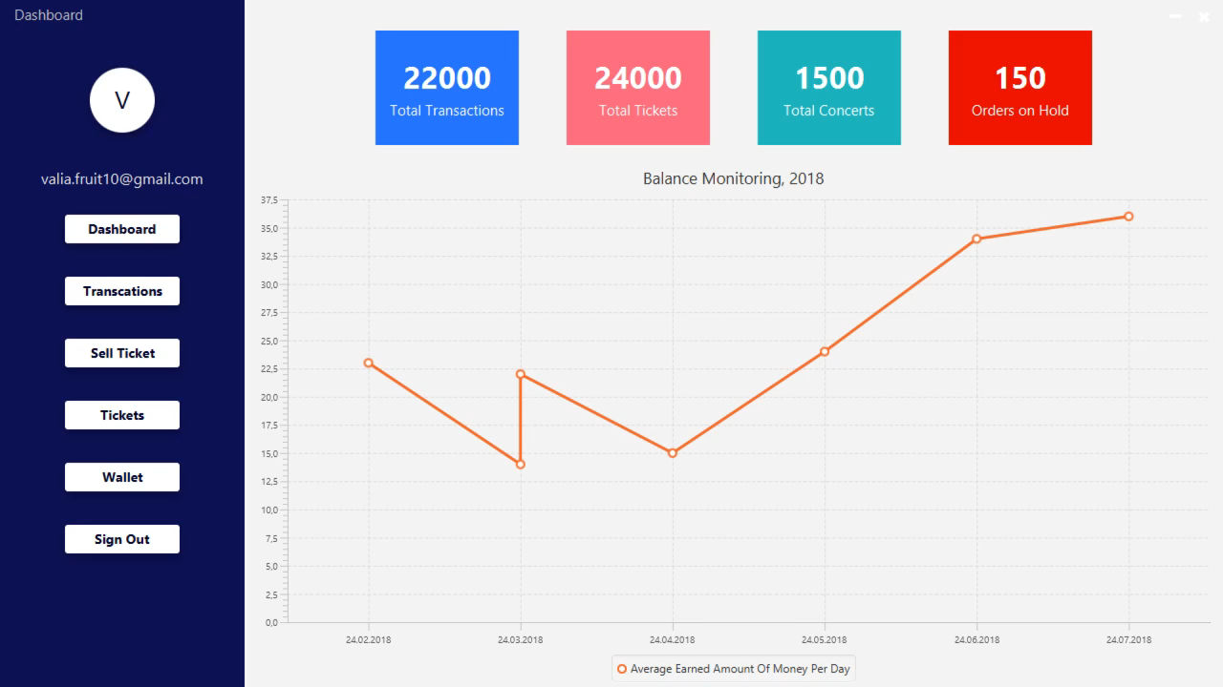
Transactions

Slide 24
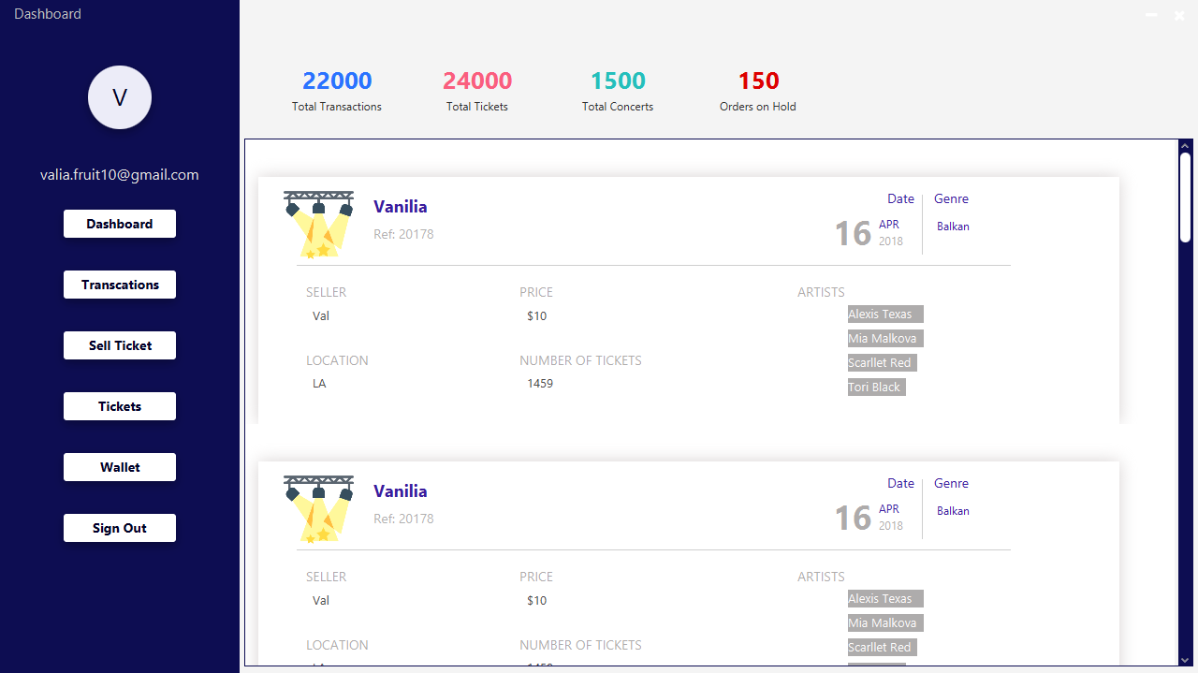
[Created] Tickets

Slide 25
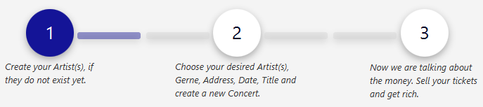
Java App – Sell Ticket
Multi-Step-Form
Form-1: Imgur Upload Service using Imugr‘s Api
https://apidocs.imgur.com/
Form–2: Implemented by using Fx‘s Webengine (JS) https://docs.oracle.com/javase/8/javafx/api/javafx/scene/web/WebEngine.html
Fancy Gallery done by using Swiper.js
http://idangero.us/swiper/

Slide 26

Sell – Ticket -View

Slide 27
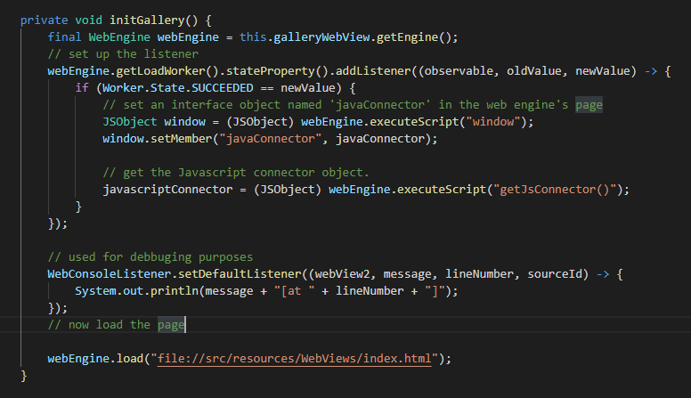
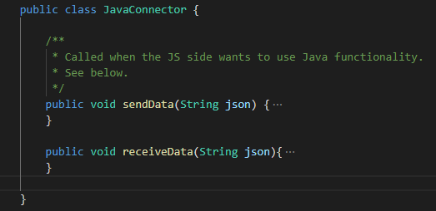
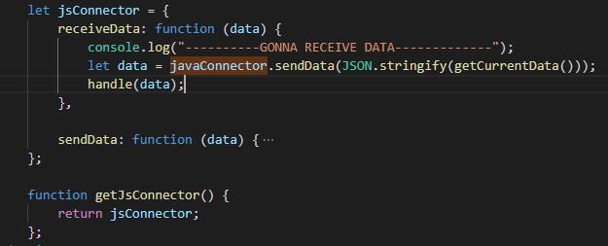
JS & Java - Communication

Slide 28
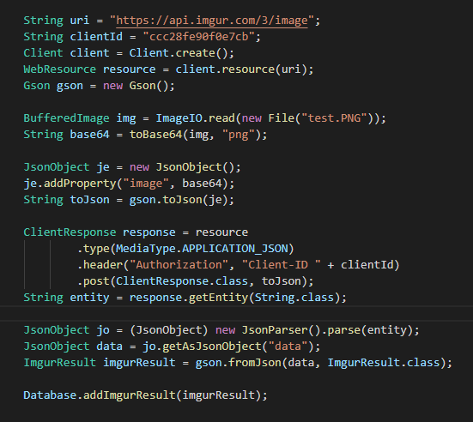
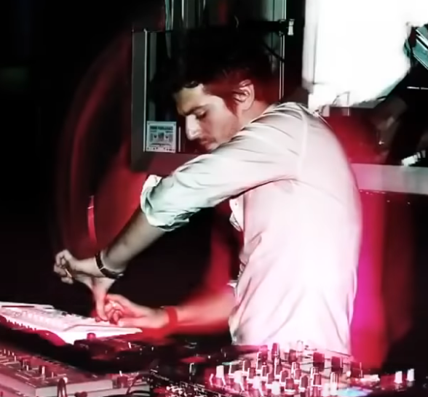

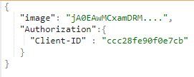

Imgur Upload Script
jA0EAwMCxamDRMfOGV5gyZPnyX1BBPOQAE4BHbh7PfTDInn+94hXmnBr9D8+4x5R kNNl4E499Me3Fotq8/zvznEycz2h7vJ21SdP5akLhRPd4W1S79LoCvbZYh2x4t6x Cnqev6S97ys4chOPgz0FePfKQos0I7+ …….
https://api.imgur.com/3/image/4324234weä#we.com

Slide 29

Wallet [Cash-In/Out]

Slide 30
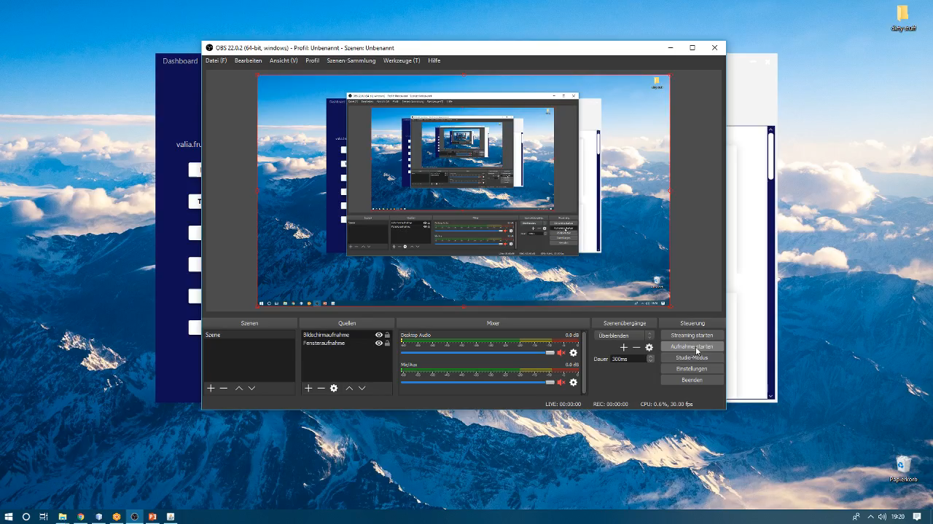
Change Password and Log-Out

Slide 31
Webservice

Slide 32
Webservice
Keine grundlegenden Änderungen
Implementierung neuer Routen
Etliche Bugfixes

Slide 33
NEEDATICKET
CONCERT TICKETS
Vielen Dank für Ihre Aufmerksamkeit!
Notes:
To change the image on this slide, select the picture and delete it. Then click the Pictures icon in the placeholder to insert your own image.

